Slide 1
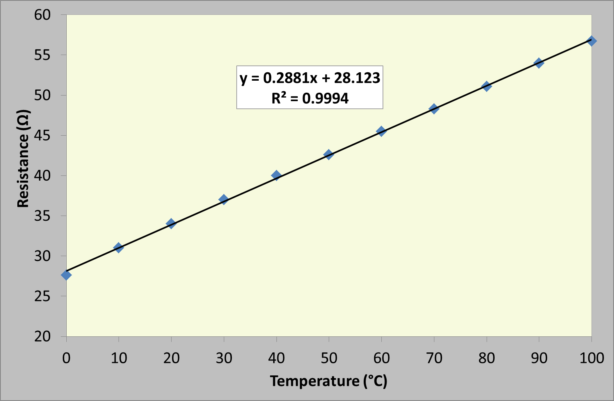
The Effect of Temperature on the Resistance of a Resistor

